Slide 1


DB POOLING & MEMORY CACHING
Presenter: Ram & Sourabh
Date: 01-07-2022

Slide 2


Introduction ABOUT ME
11 years experience in design and implementation of web application, object oriented, frameworks & cloud architecture in various business domains and currently working with an eCom client.
Ram Prakash Singh
9+ years of experience in object-oriented programming development using J2EE technologies. Worked on different integration technologies, tools and frameworks in various business domains.
Sourabh Dubey

Slide 3

PROBLEM STATEMENT – Database Pooling
Configured microservice with postgres database using ReactiveCrudRepository that supports Vertical scaling.
The problem with vertical scaling is that, in order to upgrade the server, the database service needs to be stopped. So, during the hardware upgrade, the application will not be available, which can impact underlying business operations.
Single point of failure.
Expensive and slow.
Performance Issues.
It doesn’t support Horizontal scaling.

Slide 4
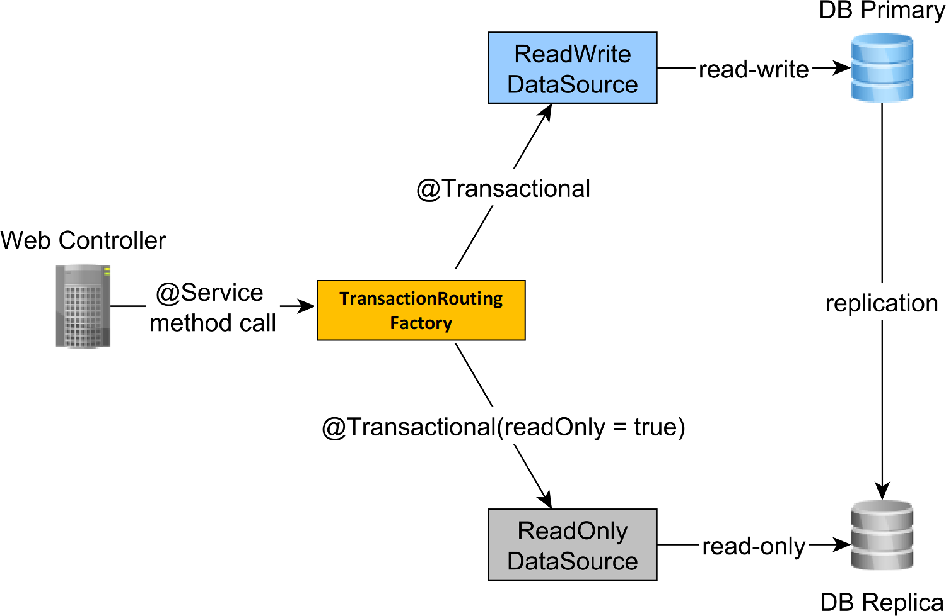
Solution
To overcome the aforementioned issues associated with having a single database server node, we can set up multiple database server nodes. The more nodes, the more resources we will have to process incoming traffic.

Slide 5
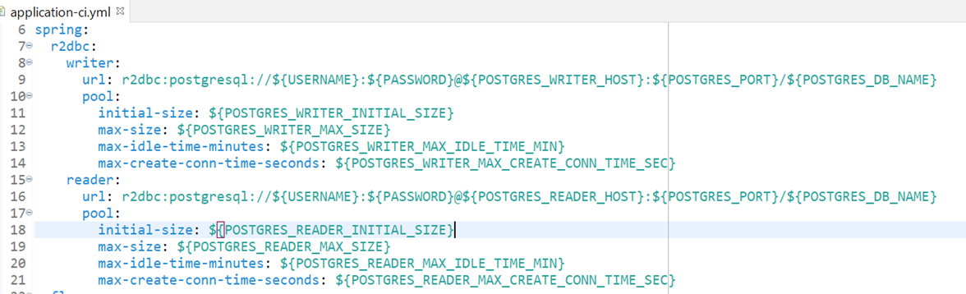
Solution
Microservices: Configurations and classes
R2DBC Postgres Connection Pooling configuration

Slide 6
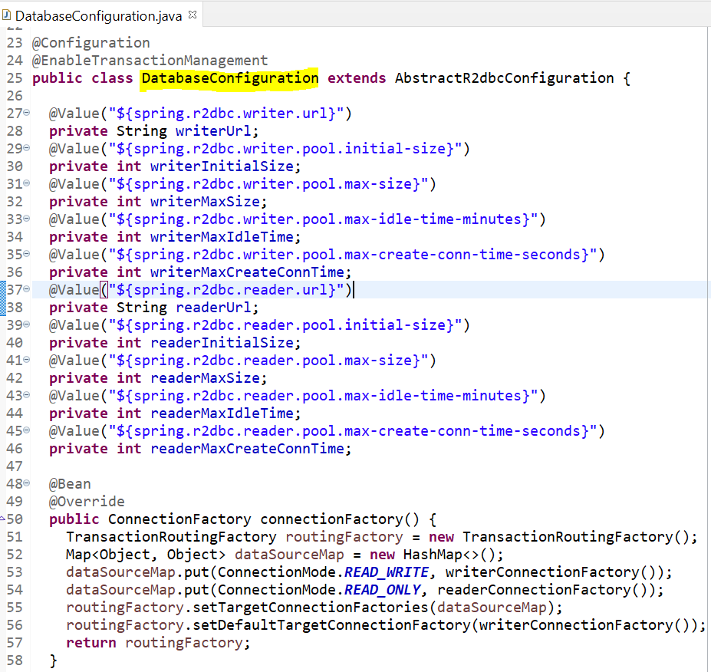
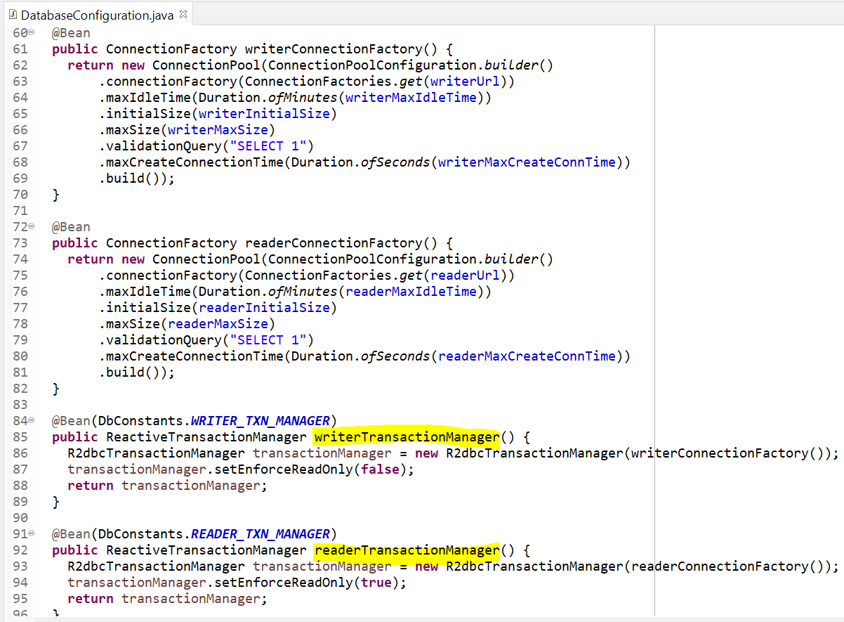
Solution
Transaction Routing Factory configuration

Slide 7
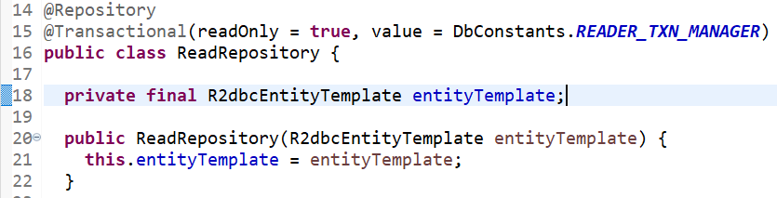
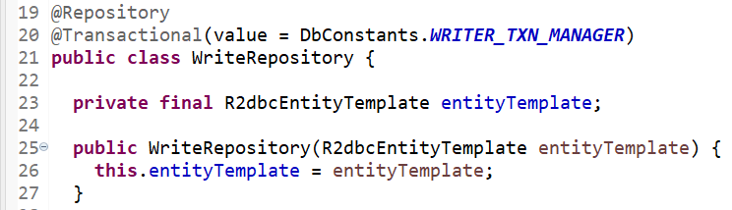
Solution
Segregating Read and Write repository

Slide 8













Tools and Technology Stack

Slide 9
PROBLEM STATEMENT – Redis Cache
Increasing load on Database
Due to large amount of configurational data stored in the database, read load on the database was increasing significantly which is negatively impacting the performance.

Slide 10
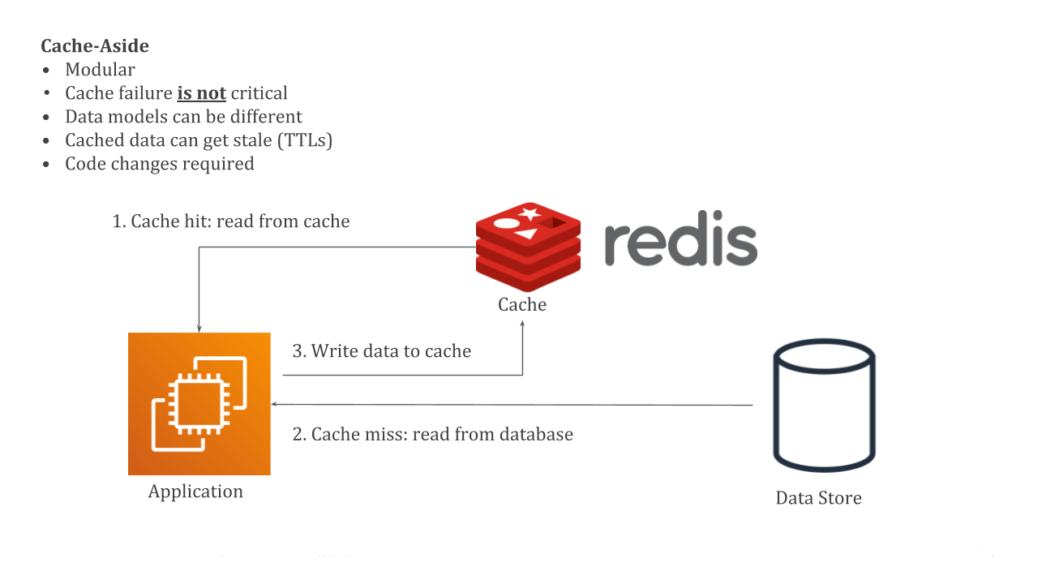
Solution – Redis Cache
To overcome the aforementioned issues associated with high load on database, we have implemented Redis cache which significantly increases the performance.

Slide 11
Summary/ Take-Away – DB pooling
DB Pooling
The load is distributed across all nodes, providing a better overall experience, increasing network performance and security, and avoiding heavy usage of the individual components.
Redis Cache
By redirecting significant parts of the read load from the backend database to the in-memory layer, caching can reduce the load on your database, and protect it from slower performance under load, or even from crashing at times of spikes.

Slide 12
Q&A

